Slide 1
Machine Learning & Deep Learning
Naive Bayes Classifier
Instructor: Najam Aziz

Slide 2
Naive Bayes Classifier

Slide 3
Natural Phenomena
Deterministic: A deterministic model does not include elements of randomness. Every time you run the model with the same initial conditions you will get the same results.
Most simple mathematical models of everyday situations are deterministic
Probabilistic: A probabilistic model includes elements of randomness. Every time you run the model, you are likely to get different results, even with the same initial conditions. A probabilistic model is one which incorporates some aspect of random variation.
-- Deterministic models can be relatively simple and can be used when random variation is not a major influence on the situation being modelled (random variation is relatively small). If random variation is a major component of the context, a probabilistic model may be needed to fit the purpose.

Slide 4
Uncertianity
When we are not sure about the input or output
To represent uncertain knowledge, where we are not sure about the predicates, we need uncertain reasoning or probabilistic reasoning.
Causes of uncertainty:
Following are some leading causes of uncertainty to occur in the real world.
Information occurred from unreliable sources.Experimental Errors
Equipment fault
Temperature variation
Climate change.

Slide 5
Probabilistic reasoning
Probabilistic reasoning is a way of knowledge representation where we apply the concept of probability to indicate the uncertainty in knowledge. In probabilistic reasoning, we combine probability theory with logic to handle the uncertainty.
We use probability in probabilistic reasoning because it provides a way to handle the uncertainty that is the result of someone's laziness and ignorance.
In the real world, there are lots of scenarios, where the certainty of something is not confirmed, such as; "It will rain today", "behavior of someone for some situations", "A match between two teams or two players." These are probable sentences for which we can assume that it will happen but not sure about it, so here we use probabilistic reasoning.
Need of probabilistic reasoning in AI:
When there are unpredictable outcomes.
When specifications or possibilities of predicates becomes too large to handle.
When an unknown error occurs during an experiment.
In probabilistic reasoning, there are two ways to solve problems with uncertain knowledge:
1. Bayes' rule, 2. Bayesian Statistics

Slide 6
Probability
Probability = Mathematics of Chance - Quantification of Uncertainty - How likely something is to happen.
The word probability was used in relation to the mathematics of chance in 1662
We use probability in daily life to make our decisions when we aren’t sure about what the outcome will be.
Many events can't be predicted with total certainty. The best we can say is how likely they are to happen, using the idea of probability.
Tossing a coin
Throwing a dice
Probability does not tell us exactly what will happen, it is just a guide/educated guess

Slide 7
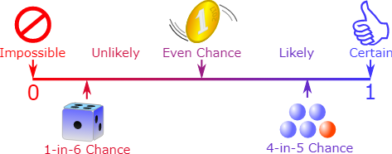

Probability is always between 0 and 1
0 ≤ P(A) ≤ 1, where P(A) is the probability of an event A.

Slide 8
Some Terminologies
Experiment: a repeatable procedure with a set of possible results.
Event: Each possible outcome of an experiement is called an event. The toss of a coin, throw of a dice and lottery draws are all examples of random events.
Events can be:
Independent (each event is not affected by other events),
Dependent (also called "Conditional", where an event is affected by other events)
Mutually Exclusive (events can't happen at the same time)
Complement of an Event: All outcomes that are NOT the event. P(A) + P(A') = 1
Random Variable: set of possible values from a random experiment. Random Variables can be either Discrete or Continuous. represent the events and objects in the real world.
Sample Space: The collection of all possible events/outcomes of an experiment.
Prior probability: The prior probability of an event is probability computed before observing new information.
Posterior Probability: The probability that is calculated after all evidence or information has taken into account. It is a combination of prior probability and new information.

Slide 9
Joint, Marginal & Conditional Probability
Joint probability: p(A and B). The probability of event A and event B occurring. It is the probability of the intersection of two or more events. The probability of the intersection of A and B may be written as p(A ∩ B) and is equal to p(A ∩ B) = p(A|B) p(B) Example: the probability that a card is a four and red =p(four and red) = 2/52=1/26. (There are two red fours in a deck of 52, the 4 of hearts and the 4 of diamonds).
Marginal probability: the pure/unconditional probability of the occurence of an event (p(A)). It is not conditioned on another event. Example: the probability that a card drawn is red (p(red) = 0.5). The probability that a card drawn is a 4 (p(four)=1/13).
Conditional probability: p(A|B) is the probability of occuring of an event A, when another event B has already occured. p(A|B) = p(A ∩ B) / p(B) Example: given that you drew a red card, what’s the probability that it’s a four (p(four|red))=2/26=1/13. So out of the 26 red cards (given a red card), there are two fours so 2/26=1/13.

Slide 10
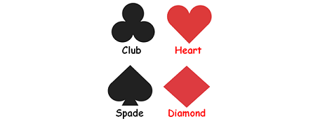
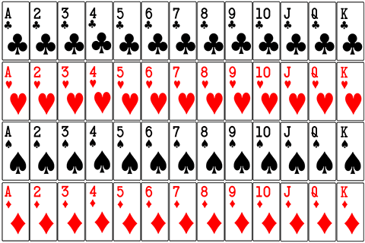
The Features of a Standard Deck of Cards
Club - 13 cards
Heart - 13 cards
Spade - 13 cards
Diamond - 13 cards
No. of black cards - 26
No. of red cards - 26
No. of Ace cards (named as "A") - 4
No. of Jack cards (named as "J" - 4
No. of Queen cards (named as "Q") - 4
No. of King cards (named as "K") - 4
No. of face cards (named as "J", "Q" and "K") - 12

Slide 11
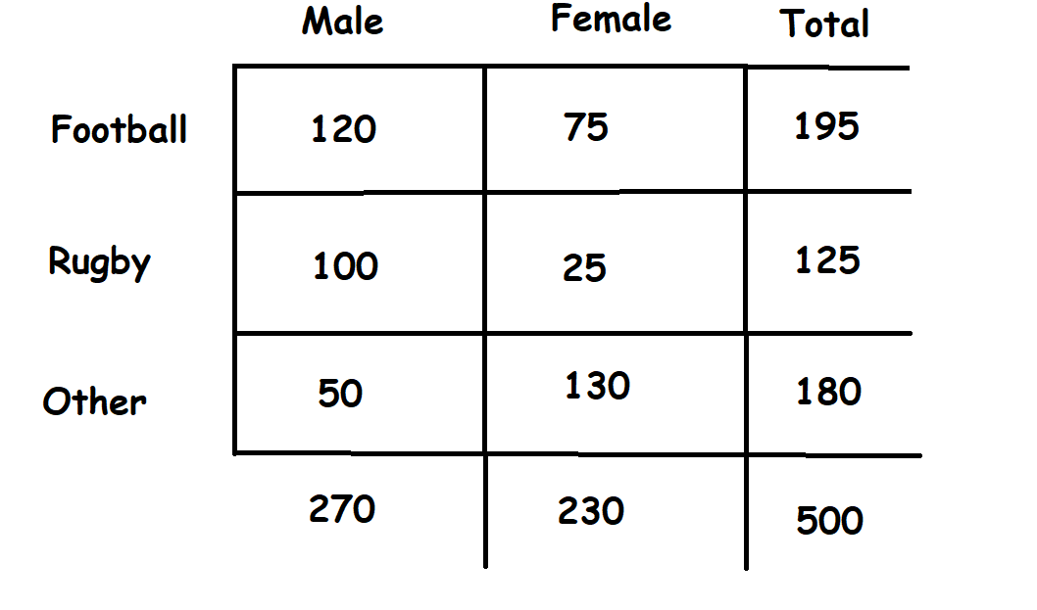
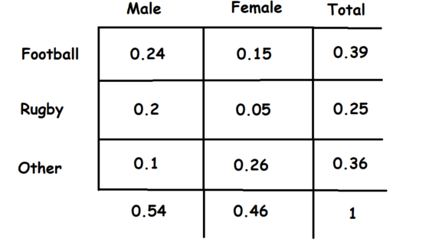
Joint, Marginal & Conditional Probability
A survey was carried out with 500 strangers to determine people’s favorite sports.

Slide 12
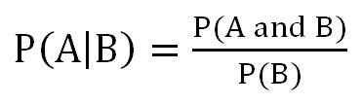
How to Manipulate among Joint, Conditional and Marginal Probabilities
The equation below is a means to manipulate among joint, conditional and marginal probabilities. As you can see in the equation, the conditional probability of A given B is equal to the joint probability of A and B divided by the marginal of B.

Slide 13
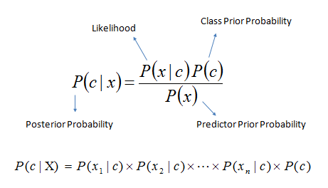

Bayes Theorem
Also known as: Bayes' rule, Bayes' law, or Bayesian reasoning, and determines the probability of an event with uncertain knowledge.
relates the conditional probability and marginal probabilities of two random events.
It is a way to calculate the value of P(B|A) with the knowledge of P(A|B).
Bayes' theorem allows updating the probability prediction of an event by observing new information of the real world.

Slide 14
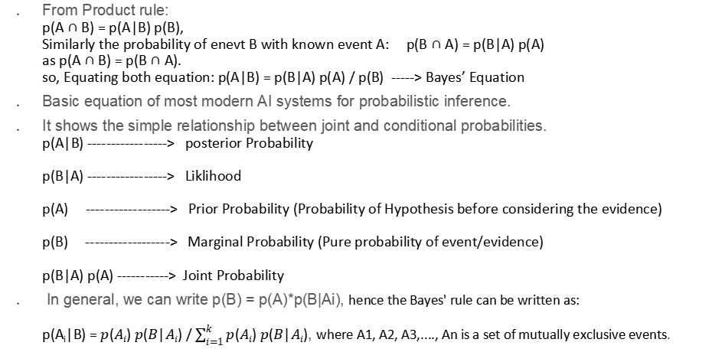
Bayes Theorem Derivation
From Product rule: p(A ∩ B) = p(A|B) p(B), Similarly the probability of enevt B with known event A: p(B ∩ A) = p(B|A) p(A) as p(A ∩ B) = p(B ∩ A). so, Equating both equation: p(A|B) = p(B|A) p(A) / p(B) -----> Bayes’ Equation
Basic equation of most modern AI systems for probabilistic inference.
It shows the simple relationship between joint and conditional probabilities. p(A|B) -----------------> posterior Probability p(B|A) -----------------> Liklihood p(A) ------------------> Prior Probability (Probability of Hypothesis before considering the evidence) p(B) ------------------> Marginal Probability (Pure probability of event/evidence) p(B|A) p(A) -----------> Joint Probability
In general, we can write p(B) = p(A)*p(B|Ai), hence the Bayes' rule can be written as: p(A_{i}|B) = $p(Ai) p(B|Ai)$ / $\sum_{i=1}^{k}{p(Ai) p(B|Ai)}$, where A1, A2, A3,...., An is a set of mutually exclusive events.

Slide 15
Why Naive - The Naive Bayes Assumption
The word naive implies that every pair of features in the dataset is independent of each other. All naive Bayes classifiers work on the assumption that the value of a particular feature is independent from the value of any other feature for a given the class.
Naive Bayes classifier assume that the effect of the value of a predictor (x) on a given class (c) is independent of the values of other predictors. This assumption is called class conditional independence.
It’s quite tedious to calculate the set of probabilities for all values again and again. Fortunately, with the naive conditional independence assumption, the conditional probabilities are independent of each other.
In terms of machine learning, we mean to say that the features provided to us are independent and do not affect each other, and this does not happen in real life. The features depend on the occurrence or value of another, which is simply ignored by the Naive Bayes classifier and is hence given the term, “NAIVE”.

Slide 16
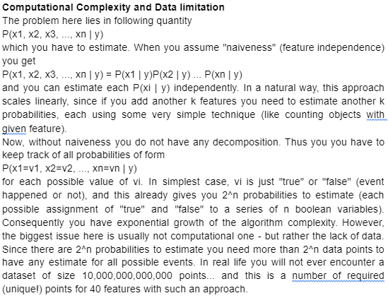

Slide 17
Naive Bayes Classifier
Supervised machine learning algorithms based on the Bayes probability theorem

Slide 18
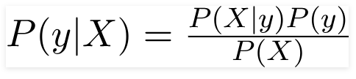

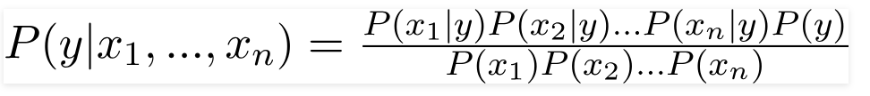


Bayes Theorem
Feature Vector
Expanding the bayes theorem using chain rule
The Denominator remains constant for all the entries in dataset, hence
Class with maximum probability

Slide 19
Types of Naive bayes Classifier
Gaussian The Gaussian Naive Bayes, is based on a continuous distribution and it's suitable for more generic classification tasks. (General use)
In Gaussian Naive Bayes, continuous values associated with each feature are assumed to be distributed according to a Gaussian distribution. A Gaussian distribution is also called Normal distribution. When plotted, it gives a bell shaped curve which is symmetric about the mean of the feature values
Multinomial Multinomial naive Bayes assumes to have feature vector where each element represents the number of times it appears (or, very often, its frequency). Works well on Discrete data, when predicted variable is not binary, but has more categories.
Bernoulli features are independent booleans (binary variables) describing inputs. Like the multinomial model, this model is popular for document classification tasks, where binary term occurrence (i.e. a word occurs in a document or not) features are used rather than term frequencies (i.e. frequency of a word in the document).

Slide 20
Use Cases
Real-time prediction: Because Naive Bayes is fast, it works well at making predictions in real-time.
Multiclass prediction: Naive Bayes works well when there are more than two classes for the output variable.
Text classification: Text classification also includes sub-applications like spam filtering and sentiment analysis. Since Naive Bayes works best with discrete variables, it tends to work well in these applications.
Recommendation systems: Naive Bayes is commonly used alongside other algorithms like Collaborative Filtering to build recommendations systems like Netflix’s recommended for you section, or Amazon’s recommended products, or Spotify’s recommended songs.

Slide 21
Advantages of Naive Bayes
When the assumption of independent predictors holds true, a Naive Bayes classifier performs better as compared to other models. & it will converge quicker than discriminative models like logistic regression.
Naive Bayes requires a small amount of training data to estimate the test data. So the training period takes less time.
Very simple, easy to implement, and fast. It can make probabilistic predictions.
It is highly scalable. It scales linearly with the number of predictor features and data points.
Can be used for both binary and multi-class classification problems.
Handles continuous and discrete data and is not sensitive to irrelevant features.

Slide 22
Disadvantages of Naive Bayes
The main limitation of Naive Bayes is the assumption of independent predictor features. Naive Bayes implicitly assumes that all the attributes are mutually independent. In real life, it’s almost impossible that we get a set of predictors that are completely independent or one another.
If a categorical variable has a category in the test dataset, which was not observed in training dataset, then the model will assign a 0 (zero) probability and will be unable to make a prediction. This is often known as Zero Frequency. To solve this, we can use a smoothing technique. Details on additive smoothing or laplace smoothing can be found here.

Slide 23
Example Problems

Slide 24
Naive Bayes Classifier
Supervised machine learning algorithms based on the Bayes probability theorem

Slide 25
Assumption:
The fundamental Naive Bayes assumption is that each feature makes an:
independent
equal
contribution to the outcome.
With relation to our dataset, this concept can be understood as:
We assume that no pair of features are dependent. For example, the temperature being ‘Hot’ has nothing to do with the humidity or the outlook being ‘Rainy’ has no effect on the winds. Hence, the features are assumed to be independent.
Secondly, each feature is given the same weight(or importance). For example, knowing only temperature and humidity alone can’t predict the outcome accurately. None of the attributes is irrelevant and assumed to be contributing equally to the outcome.
Note: The assumptions made by Naive Bayes are not generally correct in real-world situations. In-fact, the independence assumption is never correct but often works well in practice.

Slide 26
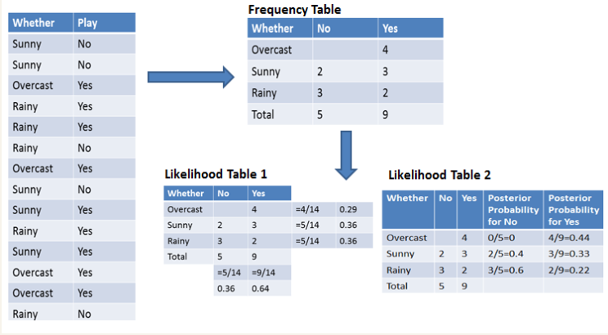
Example 1. Single Feature:
Weather: Overcast
Play: ???

Slide 27
Probability of playing:
P(Yes | Overcast) = P(Overcast | Yes) P(Yes) / P (Overcast) .....................(1)
Calculate Prior Probabilities:
P(Overcast) = 4/14 = 0.29
P(Yes)= 9/14 = 0.64
Calculate Posterior Probabilities:
P(Overcast |Yes) = 4/9 = 0.44
Put Prior and Posterior probabilities in equation (1)
P (Yes | Overcast) = 0.44 * 0.64 / 0.29 = 0.98(Higher)
Probability of not playing:
P(No | Overcast) = P(Overcast | No) P(No) / P (Overcast) .....................(2)
Calculate Prior Probabilities:
P(Overcast) = 4/14 = 0.29
P(No)= 5/14 = 0.36
Calculate Posterior Probabilities:
P(Overcast |No) = 0/9 = 0
Put Prior and Posterior probabilities in equation (2)
P (No | Overcast) = 0 * 0.36 / 0.29 = 0
The probability of a 'Yes' class is higher. So you can determine here if the weather is overcast than players will play the sport.

Slide 28
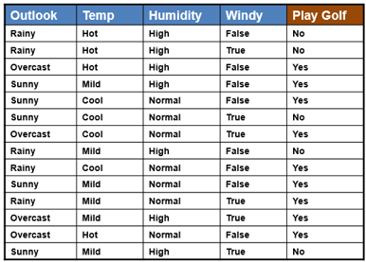
Example 2. Multiple Feature

Slide 29
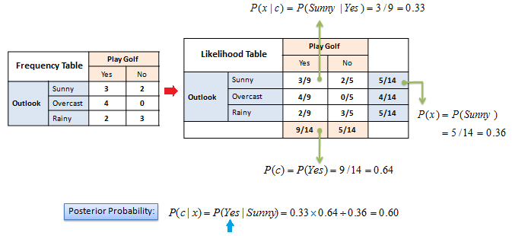
The posterior probability can be calculated by first, constructing a frequency table for each attribute against the target. Then, transforming the frequency tables to likelihood tables and finally use the Naive Bayesian equation to calculate the posterior probability for each class. The class with the highest posterior probability is the outcome of prediction.
X = (Rainy, Hot, High, False), y = No
So basically, P(y|X) here means, the probability of “Not playing golf” given that the weather conditions are “Rainy outlook”, “Temperature is hot”, “high humidity” and “no wind”.

Slide 30
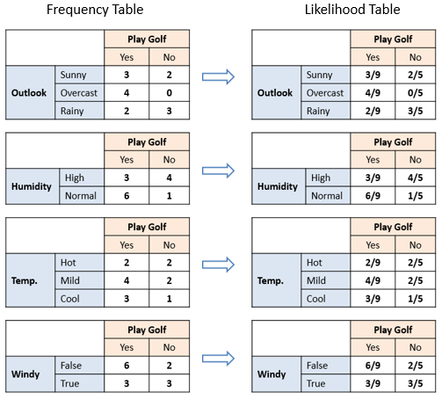
The likelihood tables for all four predictors.

Slide 31
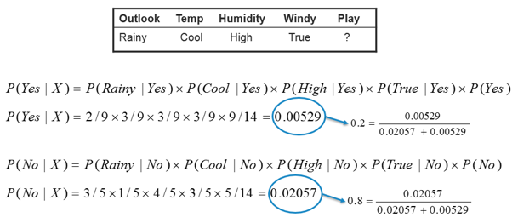

Slide 32
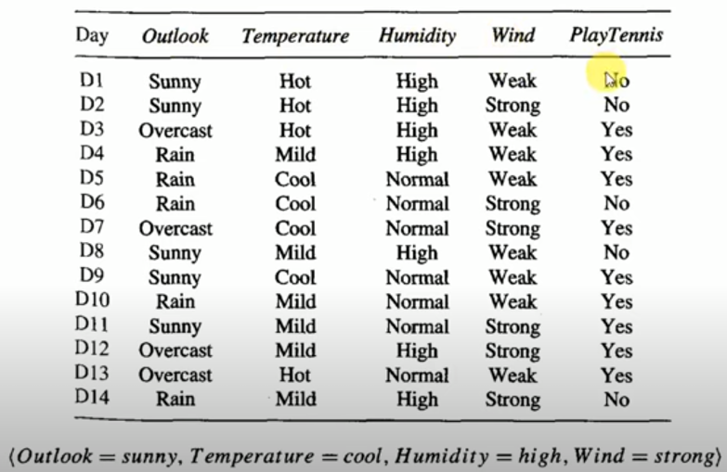
Example 3. Multiple Feature

Slide 33
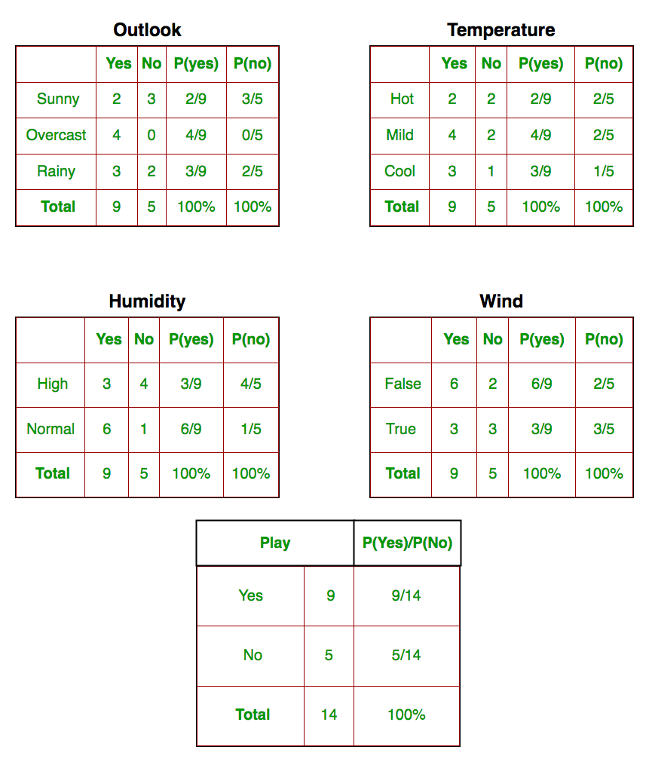
Current or Conditional Probabilities of individual Features/attributes
p(outlook/class)
p(temperature/class)
p(Humidity/class)
p(wind/class)
Class Prior Probability

Slide 34
So, in the figure above, we have calculated P(xi | yj) for each xi in X and yj in y manually in the tables 1-4. For example, probability of playing golf given that the temperature is cool, i.e P(temp. = cool | play golf = Yes) = 3/9.
Also, we need to find class probabilities (P(y)) which has been calculated in the table 5. For example, P(play golf = Yes) = 9/14.
So now, we are done with our pre-computations and the classifier is ready!
Let us test it on a new set of features (let us call it today):
today = (Sunny, Hot, Normal, False)

Slide 35
So, probability of playing golf is given by:
and probability to not play golf is given by:
Since, P(today) is common in both probabilities, we can ignore P(today) and find proportional probabilities as:
And
Now, since
These numbers can be converted into a probability by making the sum equal to 1 (normalization):
And
Since; P(Yes/Today) > P(No/Today)
So, the Prediction that Golf will be played is: YES

Slide 36
Implementation in Python Sklearn

Slide 37
Model Building
#Import Gaussian Naive Bayes model
from sklearn.naive_bayes import GaussianNB
#Create a Gaussian Classifier
gnb = GaussianNB()
#Train the model using the training sets
gnb.fit(X_train, y_train)
#Predict the response for test dataset
y_pred = gnb.predict(X_test)
Model Evaluation
#Import scikit-learn metrics module for accuracy calculation
from sklearn import metrics
# Model Accuracy, how often is the classifier correct?
print("Accuracy:",metrics.accuracy_score(y_test, y_pred))

Slide 38
References
AI tutorials
https://www.javatpoint.com/
Probabilistic reasoning in Artificial intelligence https://www.javatpoint.com/probabilistic-reasoning-in-artifical-intelligence
Bayes' theorem in Artificial intelligence https://www.javatpoint.com/bayes-theorem-in-artifical-intelligence
Bayesian Belief Network in artificial intelligence https://www.javatpoint.com/bayesian-belief-network-in-artificial-intelligence
Naive Bayes Classification Tutorial using Scikit-learn
https://www.datacamp.com/tutorial/naive-bayes-scikit-learn
Naive Bayes Classifiers
https://www.geeksforgeeks.org/naive-bayes-classifiers/
Naive Bayesian
https://www.saedsayad.com/naive_bayesian.htm

Slide 39


Slide 40
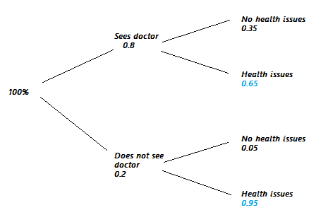
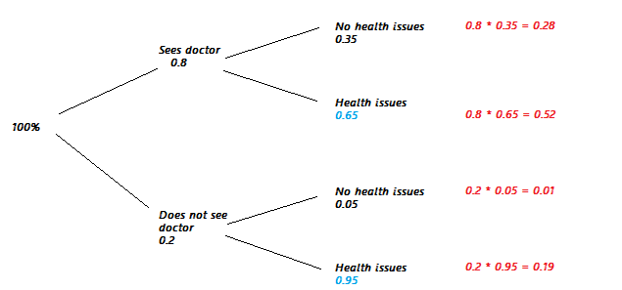
Law of Total Probability
Find the probabilities that answer the question. For this example, we want the probability a random person will have no health problems.
0.28 + 0.01 = 0.29.

